Slide 1
Team 3 Use Case Model
Che Li,
Chang Li,
Yuting Wang,
Yakun Zhang

Slide 2
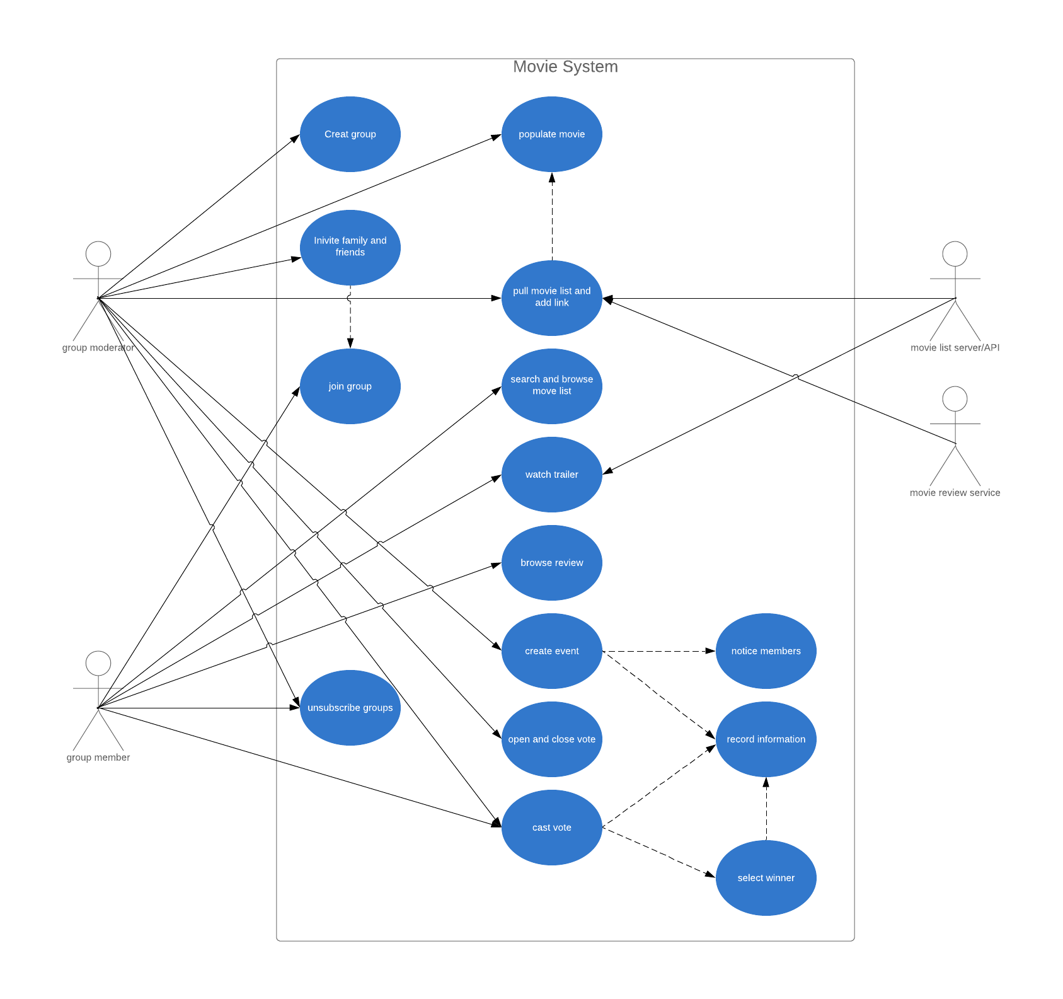
Diagram

Slide 3
Actors Definition
Moderator: The initiator of the entire event is the operator of the entire system, with most of the permissions.
Group members: Participants throughout the event, with certain permissions.
Movie list server/API: provide movie lists in system
Movie review service: provide movie reviews in system

Slide 4
Actors - Moderator
Create a group
Invite people
Unsubscribe group
Populate movie lists
Pull movie list and trailers from movie list server/API
Create an event
Open and close a vote for an event
Cast vote

Slide 5
Actors – Group Members
Join group
Unsubscribe group
Search and browse movie list
Watch trailer
Browse review
Cast vote

Slide 6
Actors - Movie list server/API
Provide movie lists
Provide movie trailer

Slide 7
Actors - Movie review service
Provide movie review link

Slide 8
Use Case
Create group : moderator could create a movie group
Invite family and friend: moderator could invite people to join in the groups
Join group: family and friends could join in a movie group
Unsubscribe: people could unsubscribe a movie group
Populate movie: moderator could populate movie to the group list
Pull movie and add link: moderator could add the movie link URL that provided by the movie list server/API to the group
Search and browse movie list: family and friends could search and browse movie lists in a group

Slide 9
Use Case
Watch trailer: family and friends could watch a trailer in a group
Populate review link: moderator could add review link, which provided by the movie review service
Browse and add review: family and friends could browse and add review
Create event: moderator could create a watching event and system could notified it to group members
Notice member: a movie watching event was created and that they can vote for the movies that they want (or do not want) watch in this movie watching event
Open and close a vote: moderator could open and close a vote for a movie
Vote: people could vote for whether they want to watch a movie
Record information: system could record the vote information

Slide 10
Constrain
The history of movie watching events, votes, and winners only be available for the participants of the movie watching group
The system shall not allow participants of a movie watching group to change their votes AFTER the system computed the winner movie based on casted votes

